Slide 1

YEAR 3 &4
SPEAK LIKE AN EXPERT
World War II
Autumn 2022

Slide 2
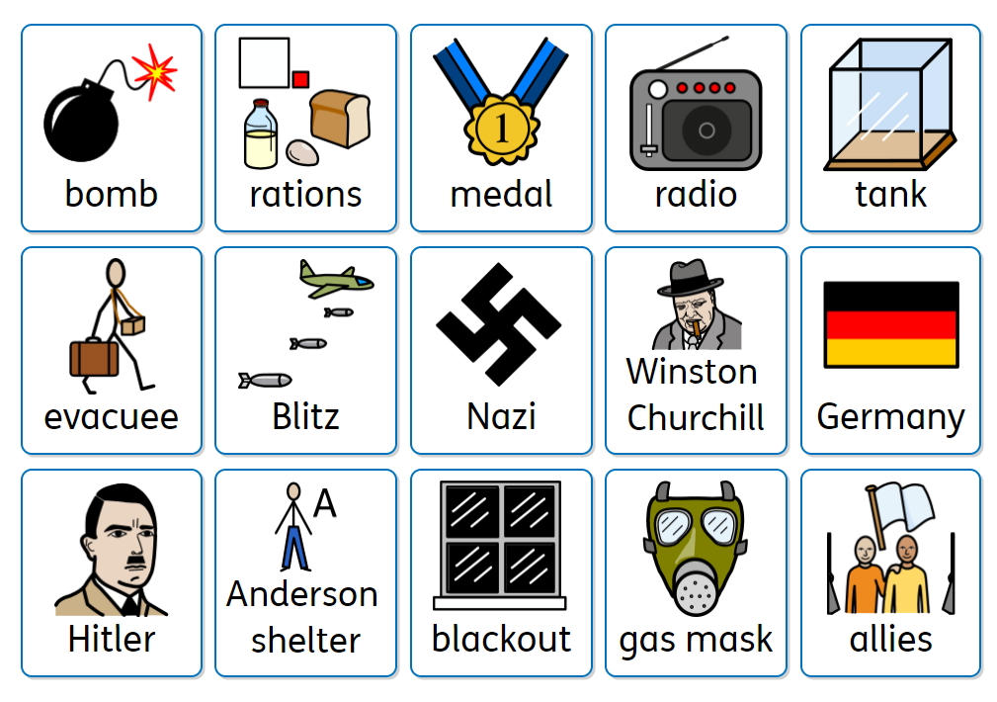

Slide 3
YEAR 5 & 6
SPEAK LIKE AN EXPERT
World War II
Autumn 2022

Slide 4


