Slide 1

YEAR 3 &4
SPEAK LIKE AN EXPERT
THE GREAT WAR
Autumn 2022

Slide 2







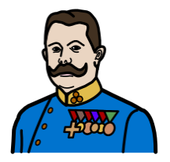

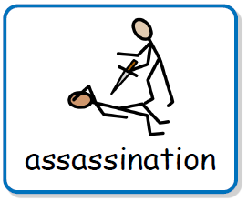
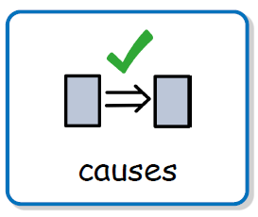
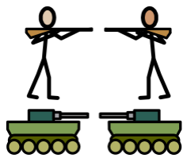
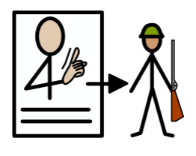
 |  |  |  | propaganda
 |  | truce | Battle of the Somme
rations
Archduke Franz Ferdinand
weapons
Battle of the Somme
conscription

Slide 3
YEAR 5 & 6
SPEAK LIKE AN EXPERT
THE GREAT WAR
Autumn 2022

Slide 4
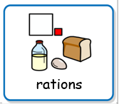

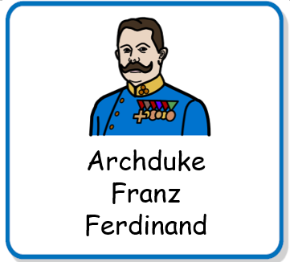


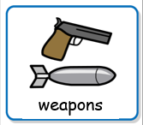

 |  |  |  | rationing
 |  |  |  | propaganda
Battle of the Somme |  | truce | imperialism
nationalism
militarism

