Slide 1

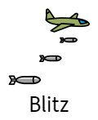







 |  |  | Axis Powers
 | Home Front | propaganda | rationing | Anderson Shelter
 |  | Chamberlain

